Slide 1
ACMA 231
Excel: Charts and
Conditional Formatting

Slide 2
Charts (graphs) are another way to summarize data in Excel. The advantage of using charts is that they allow you to present information graphically, which can help you or your audience visualize trends or comparisons.
Excel: Charts and Conditional Formatting
There are many different types of charts built into Excel. We will focus on the following most common types:
Bar Charts
Line Charts
Pie Charts
Components of a Chart:
Vertical and Horizontal Axes
Data Series
Legend
Chart Title
Axis Titles

Slide 3
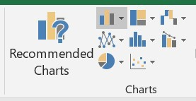
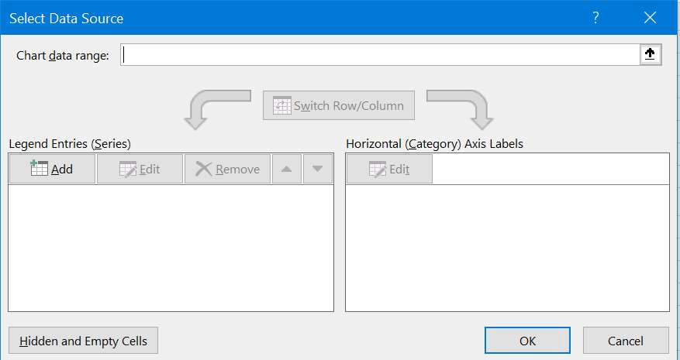
To build charts, go to the Input tab on the ribbon and look for the chart section in the middle of the ribbon:
Excel: Charts and Conditional Formatting
Bar Charts Line Charts Pie Charts
Select the type of chart you would like, then select “Select Data” on ribbon tab that shows.
Select the data desired.
It should populate the axis properly, but if not, you can change your selections here or later.
3

Slide 4

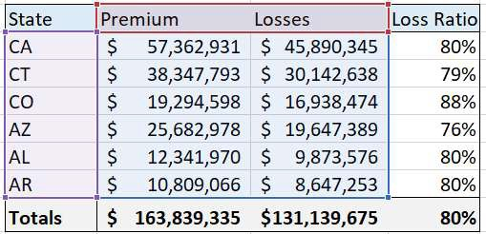
By clicking in the chart, you will see the following buttons show to the right of the chart:
Excel: Charts and Conditional Formatting
Click on this to add items to the chart. For example, you may want to add a legend, axis titles, or other items.
Click on this to change the formatting of your chart. There are many options here to make your chart look any way you’d like.
Click on this to filter the data you’d like to see in your chart.
Also note that you can easily change the data ranges underlying your chart by adjusting the colored sections showing on your data when clicking in the chart
4

Slide 5

By clicking in the chart, you will also see a Chart Tool tab added to the ribbon with the following sub-tabs:
Excel: Charts and Conditional Formatting
The Design tab will allow you to change the chart type, change the way the chart looks, change the data, among other things. The Format tab allows you to change the chart titles, fonts, colors, etc. You can also get to formatting by double-clicking on the chart – a side window will appear with many formatting options.

Slide 6
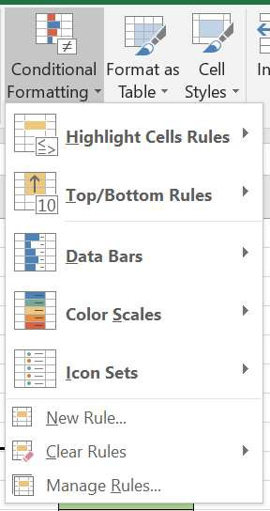
In the Home tab of the ribbon, there is a choice for Conditional Formatting, which will give you the option of
formatting cells based off of their contents and other possible rules:
Excel: Charts and Conditional Formatting
Just highlight the cells you want to be conditionally formatted and then select the type of formatting and criteria desired.
You can also manage existing rules for previously assigned formatting. A rule is the criteria given and the resultant formatting.
There are other cool things you can do, like small data bars or heat mapping the cells.
Cool stuff!

